Slide 1

Employee Management System with AI-based Attendance
Laiba Khan (2022-CS-70)
Alishba Mazhar (2022-CS-74)

Slide 2
Agenda
Introduction
Problem Statement
Non-AI Features
AI Features
Conclusion
Results
Presentation Title

Slide 3

Introduction
AI-powered Employee Management System for automated attendance via facial recognition.
Traditional methods (e.g., biometric, manual registers) are time-consuming and error-prone.
Facial recognition ensures quick, accurate attendance marking, eliminating issues like fraud
Manages additional HR tasks such as employee profiles, salaries, and promotions.

Slide 4
Primary goals
Simplify attendance tracking with AI.
Automate HR processes such as salary and promotion management.
Provide a scalable, secure solution for growing organizations.
Ensure transparent and reliable employee data management.

Slide 5
Non-AI Featrures
Login: Secure access for users based on roles.
Employee Management: Add, update, delete, and view employee profiles.
Salary Management: Calculate and pay salaries efficiently.
Attendance Tracking: Automated facial recognition for accuracy.
Promotion Management: Track and update employee career progression.

Slide 6
AI Feature (Methodology)
Data Preparation: Encode employee images for recognition.
Face Recognition: Detect and recognize faces in real-time.
Attendance Logging: Automatically update attendance records.
Model Optimization: Continuous training with diverse datasets.
Technologies Used:
Python, OpenCV, face_recognition library.

Slide 7
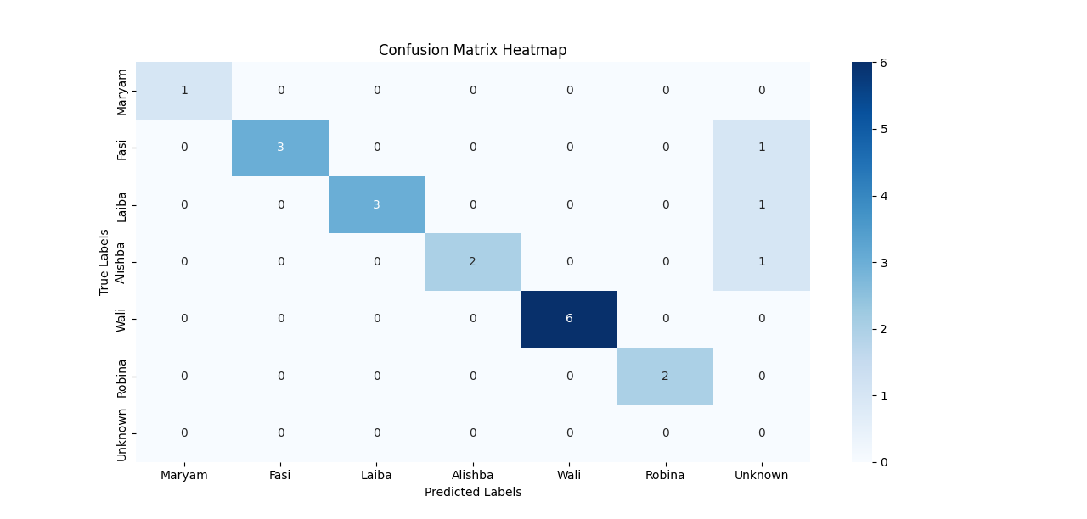
Result with wrong detection
A confusion matrix is constructed using confusion_matrix() from scikit-learn.
To show the performance of the system in correctly or incorrectly identifying individuals.
These are the results when model behave abnormal at sometimes not detect the images correctly.
Evaluation matrices | Values
Accuracy | 85%
Precision | 86%
Recall | 74%
F1- Score | 79%

Slide 8
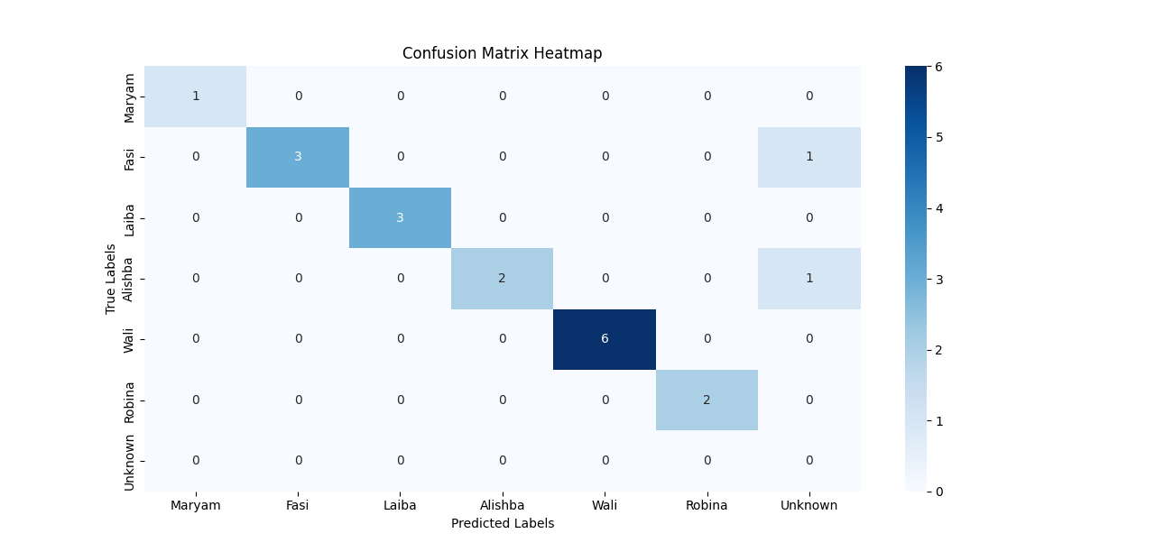
Results with More training
A confusion matrix is constructed using confusion\_matrix() from scikit-learn.
These are the results when model id trained on more images to get accurate result.
After training the model on more images ,model raise the accuracy and detects correctly.
Evaluation matrices | Values
Accuracy | 89%
Precision | 86%
Recall | 87%
F1- Score | 81%

Slide 9


Conclusion
AI-powered attendance tracking using facial recognition reduces errors and fraud.
Efficient HR management with automated handling of employee profiles, salaries, and promotions.
Improved accuracy in face recognition with higher performance metrics.
Scalable system that grows with the organization’s needs.
Saves time and reduces errors, improving transparency in employee management.

Slide 10




Thank you

